Slide 1


Analysis of a Thulium Fiber Laser and of Proposed Experimental Tests
Alex Friedrichsen
University of North Texas
Senior Thesis Presentation
Notes:
“This is what my thesis is over”. Analysis over Ronnie Curry’s dissertation – a simple model of the laser’s application. Discrepancy between experiment and theoretical results. Threshold = 2x what we expected. Some of our variables aren’t very accurate and so we used Mathematica to make certain parameters stricter for more accurate results. The next page will outline this presentation. This is a potential solution to unreliable constants. Set it up as a mystery or puzzle with this thesis as a sort of possible/likely solution. Catch their attention.

Slide 2
What I’ll be Going Over in This Presentation
An Issue Presented in
Ronnie’s Dissertation
Suspect of The Issue &
Setbacks Throughout
The Year
How The Laser Operates
& Where The Issue
Comes Into Play
Our Purchases From ITF &
Edmund Optics and How
They’ll Help
Theoretical Modelling ,
Different R Constants,
Density Dependent
Lifetime Analysis
In-Lab Experience With
Splicing, Fusing, and Spot
Welding

Slide 3
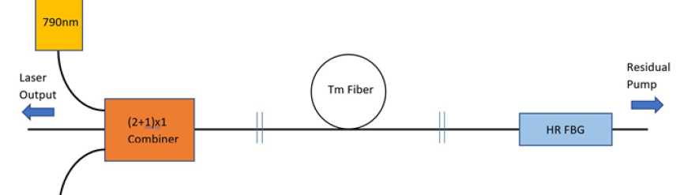
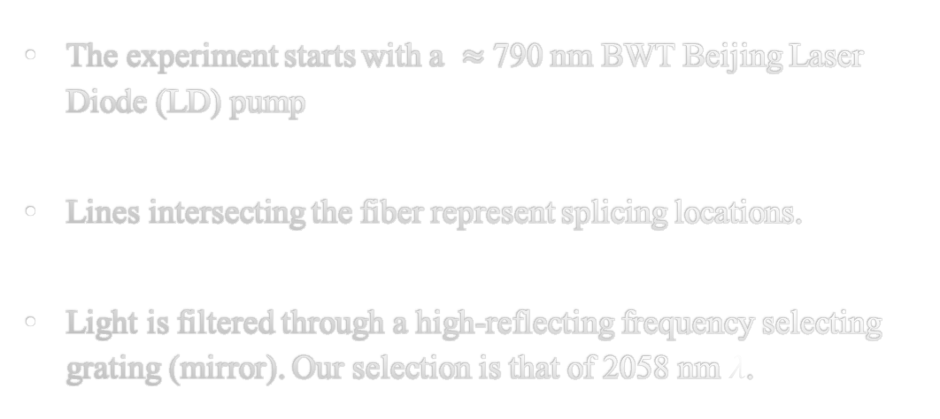
Schematic of The Laser Operation
The experiment starts with a $≈$790 nm BWT Beijing Laser Diode (LD) pump
Lines intersecting the fiber represent splicing locations.
Light is filtered through a high-reflecting frequency selecting grating (mirror). Our selection is that of 2058 nm $λ$.
We could add another laser into the combiner to increase the power input.
Notes:
Initial 105 µm multimode fiber and into the combiner. 125 µm double clad fiber after combiner.
The temperature is stabilized by a thermoelectric cooler (TEC) to contain a locked wavelength.
Goes “through” the combiner upon exit, not into. Mention the acrylic recoat at a super low index in order to achieve total internal reflection. Purpose of combiner is to transmit the 790 light into the cladding of the 125 um fiber.

Slide 4
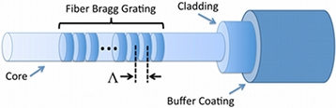
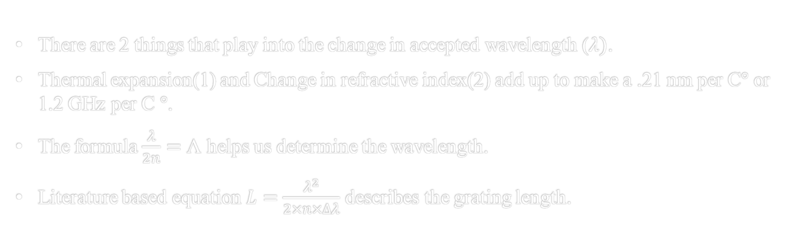
Fiber Bragg Grating (FBG) Workings
*Not drawn to scale.*
There are 2 things that play into the change in accepted wavelength ($λ)$.
Thermal expansion(1) and Change in refractive index(2) add up to make a .21 nm per C° or 1.2 GHz per C °.
The formula $\frac{λ}{2n}=\text{Λ}$ helps us determine the wavelength.
Literature based equation $L=\frac{λ^{2}}{2×n×∆λ}$ describes the grating length.
Notes:
Change in refractive index affects the accepted wavelength about 5x more than thermal expansion.
.21 nm/c based on taking difference in C from 2058 and 2059 nm wavelength. Reference Ronnie’s dissertation
Mainly due to change in refractive index.
Our grating length is 1.1 mm with a bandwidth = 1.2 nm and refractive index of 1.45

Slide 5
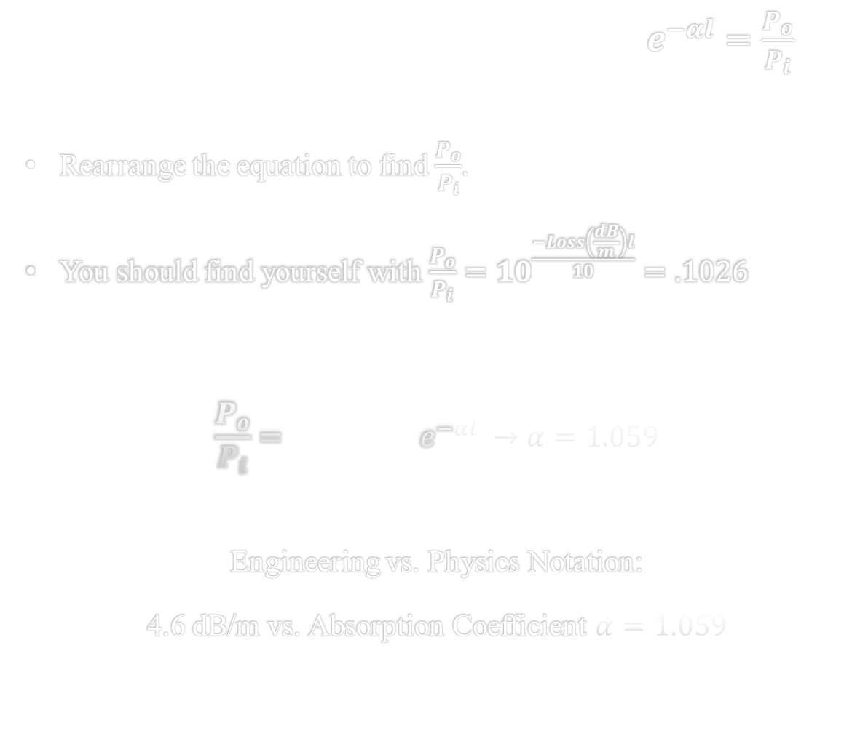
Pump Absorption Throughout The Fiber
$Loss\left(\frac{dB}{m}\right)l=−10 Log(e^{−αl})$ where $e^{−αl}=\frac{P_{o}}{P_{i}}$
Rearrange the equation to find $\frac{P_{o}}{P_{i}}$.
You should find yourself with $\frac{P_{o}}{P_{i}}={10}^{\frac{−Loss\left(\frac{dB}{m}\right)l}{10}}=.1026$
Using this, you can also find $α.$
$$\frac{P_{o}}{P_{i}}=0.1026=e^{−αl} →α=1.059$$
Engineering vs. Physics Notation:
4.6 dB/m vs. Absorption Coefficient $α=1.059$
Notes:
The light spends a large majority of its time within the outer cladding, and this is why the light doesn’t get absorbed too quickly. It only passes through the core a little bit for how much time it spends in the cladding.
The extra negative disappears because Ln(0.1026)= a negative number. So they can cancel.

Slide 6

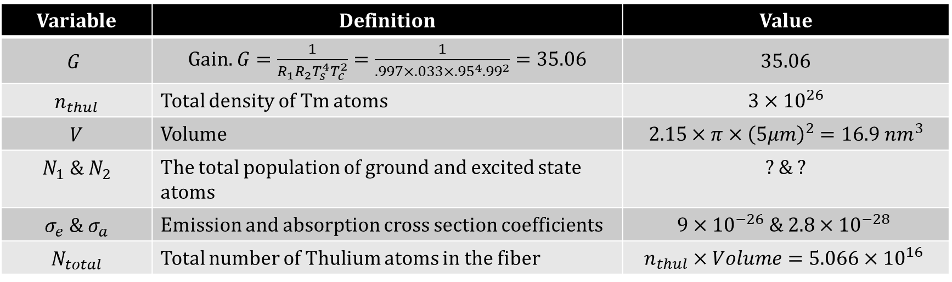
The Round Trip – Gain Equation
$$G=e^{\frac{2Γ}{A}}(N_{2}σ_{e}−σ_{a}N_{1})$$
Variable | Definition | Value
$$G$$ | Gain. $G=\frac{1}{R_{1}R_{2}T_{s}^{4}T_{c}^{2}}=\frac{1}{.997×.033×{.95}^{4}.{99}^{2}}=35.06$ | 35.06
$$n_{thul}$$ | Total density of Tm atoms | $$3×{10}^{26}$$
$$V$$ | Volume | $$2.15×π×{\left(5μm\right)}^{2}=16.9 nm^{3}$$
$$N_{1} \& N_{2}$$ | The total population of ground and excited state atoms | ? & ?
$$σ_{e} \& σ_{a}$$ | Emission and absorption cross section coefficients | $$9×{10}^{−26} \& 2.8×{10}^{−28}$$
$$N_{total}$$ | Total number of Thulium atoms in the fiber | $$n_{thul}×Volume=5.066×{10}^{16}$$
$$35.06=e^{\frac{2\left(.75\right)}{(7.86n{m)}^{2}}}\left(\left(N_{2}\left(9×{10}^{−26}\right)−\left(2.8×{10}^{−28}\right){(N}_{total}−N_{2}\right)\right)$$
Notes:
Just defining some variables, no pressure. No need to go into too much detail.
Capital Gamma is the modal overlap – a technical constant. =.75. Essentially 75% in core, and 25% outside.
Point out that the 35.06 is the gain eqn result. We know at threshold the r-trip gain = loss.

Slide 7
Gain Equation Continued
$$35.06=e^{\frac{2\left(.75\right)}{(7.86n{m)}^{2}}}\left(\left(N_{2}\left(9×{10}^{−26}\right)−\left(2.8×{10}^{−28}\right){(N}_{total}−N_{2}\right)\right)$$
$$\ln{35.06}=\frac{2\left(.75\right)}{(7.86n{m)}^{2}}\left(N_{2}\left(9×{10}^{−26}+N_{2}(2.8×{10}^{−28}\right)−1.42×{10}^{−11}\right)$$
$$3.557=1.91×{10}^{10} \left(N_{2}\left(9×{10}^{−26}+2.8×{10}^{−28}\right)−1.42×{10}^{−11}\right)$$
$$2\text{Å}=N_{2}(9.028×{10}^{−26})$$
$$N_{2}=\frac{2.0043\text{Å}}{9.028×{10}^{−26}}=2.22×{10}^{15}=4.32\% of N_{total}$$
*This is required for later equations*
Notes:
Note how this N2 is for the population throughout the whole length, not our N2 for 10 cm.

Slide 8
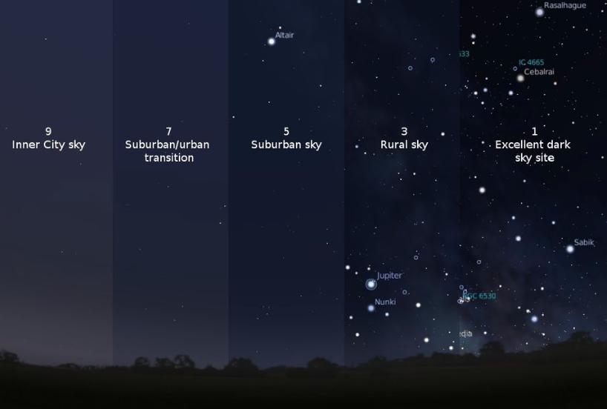
Up Next: The Decay Rate / Equilibrium Equation
Equation Purpose: Defining the excited state population of Tm atoms.
The light from the LD is absorbed leaving little of it left by the time it reaches the end of the fiber.
Compare it to the stars in polluted skies -

Slide 9
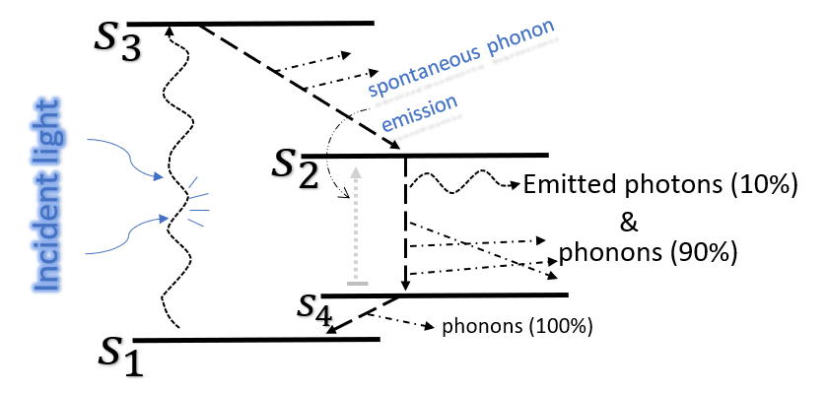

Equilibrium Population of $N_{2}$: Rate in = Rate out
$$\frac{{CR (P}_{th})}{{hv}_{pump}}=γ_{0}N_{2}+\frac{2kN_{2}^{2}}{V_{abs}}=\frac{N_{2}}{τ_{eff}}$$
CR stands for Cross Relaxation.
Our tested CR is 1.6.
How does it affect the slope efficiency?
The value of k serves as the cross-relaxation coefficient. Its importance is discussed later
Notes:
This is an only average coefficient when compared to higher coefficients of 1.8 or 1.9. This coefficient tells how many 2058 photons are output per 1 photon input. So around 60% of the time when N3 decays to N2, a nearby Tm atom is excited to the N2 state.
The cross relaxation coefficient. The slope efficiency is drastically improved when implementing CR. Threshold power (next slide) can also be reduced from CR since more 2058 photons will be emitted through CR.

Slide 10
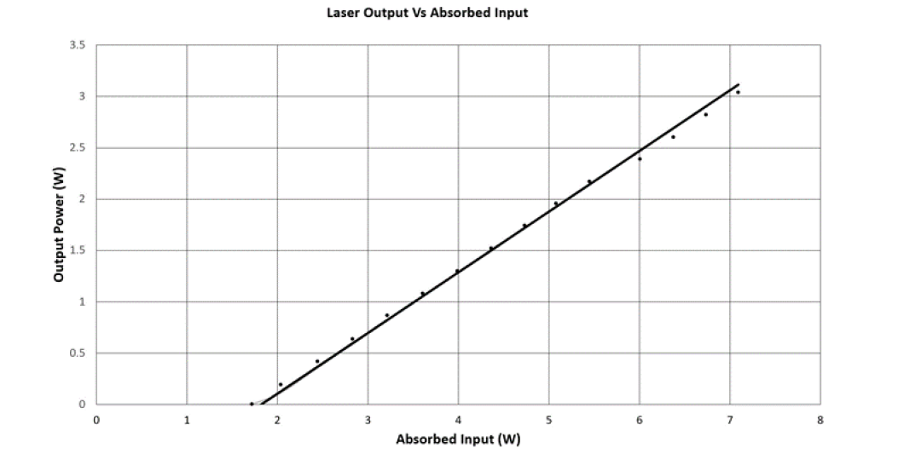
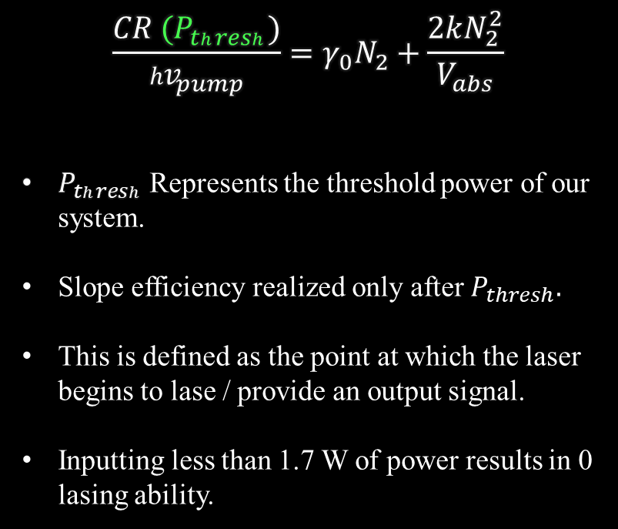

Graph Depicting Power Input vs. Output & Threshold Power ($P_{thresh}$)
$$\frac{{CR (P}_{thresh})}{{hv}_{pump}}=γ_{0}N_{2}+\frac{2kN_{2}^{2}}{V_{abs}}$$
$P_{thresh}$ Represents the threshold power of our system.
Slope efficiency realized only after $P_{thresh}.$
This is defined as the point at which the laser begins to lase / provide an output signal.
Inputting less than 1.7 W of power results in 0 lasing ability.
Power Out (W)
Power in (W)
Notes:
The more 793 nm light we pump with, the more our Tm will be willing to excite into higher states. Naturally when we have a high rate of entry into the N2 state, there will have to be an equal rate of N2 leaving that state in order to achieve equilibrium.

Slide 11
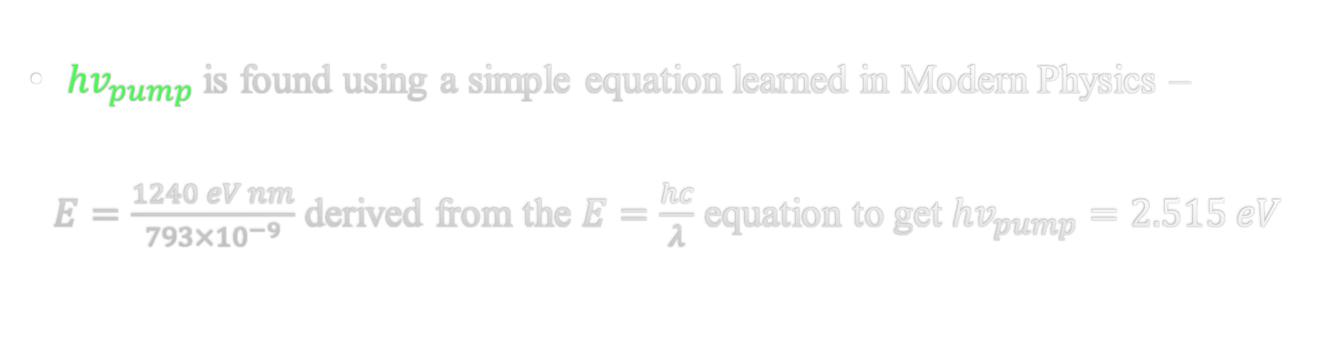

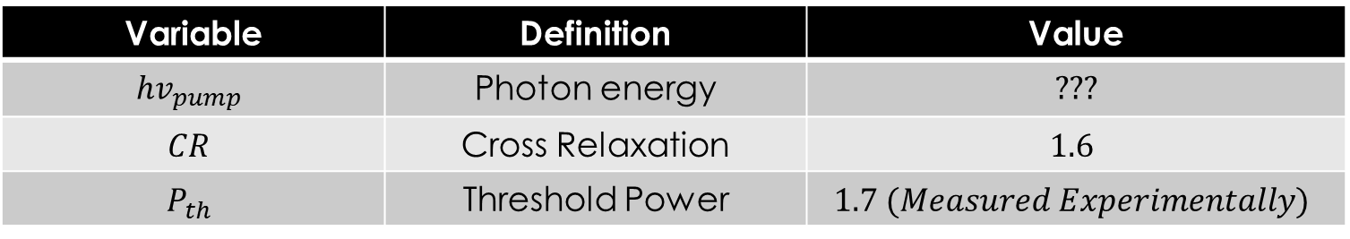
The Completed Left-Hand Side of The Equilibrium Equation
$$\frac{{CR (P}_{th})}{{hv}_{pump}}=1.0816×{10}^{19}$$
Variable | Definition | Value
$${hv}_{pump}$$ | Photon energy | ???
$$CR$$ | Cross Relaxation | $$1.6$$
$$P_{th}$$ | Threshold Power | $$1.7 (Measured Experimentally)$$
${hv}_{pump}$ is found using a simple equation learned in Modern Physics –
$E=\frac{1240 eV nm}{793×{10}^{−9}}$ derived from the $E=\frac{hc}{λ}$ equation to get ${hv}_{pump}=2.515 eV$
Notes:
Begin with the following literature values.
"We will explain how we got this shortly"

Slide 12
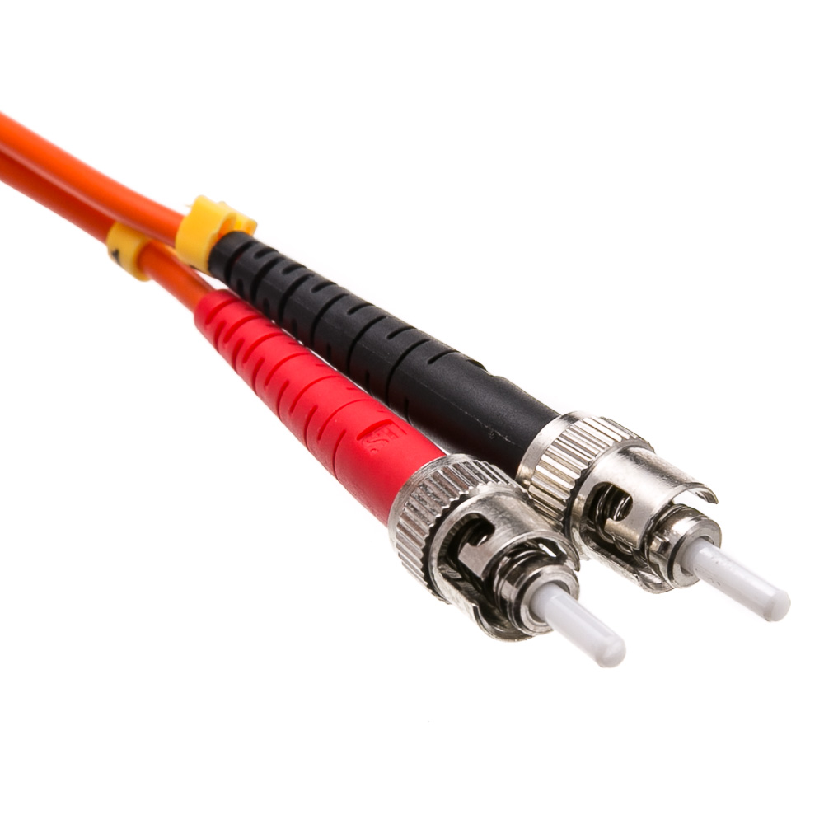

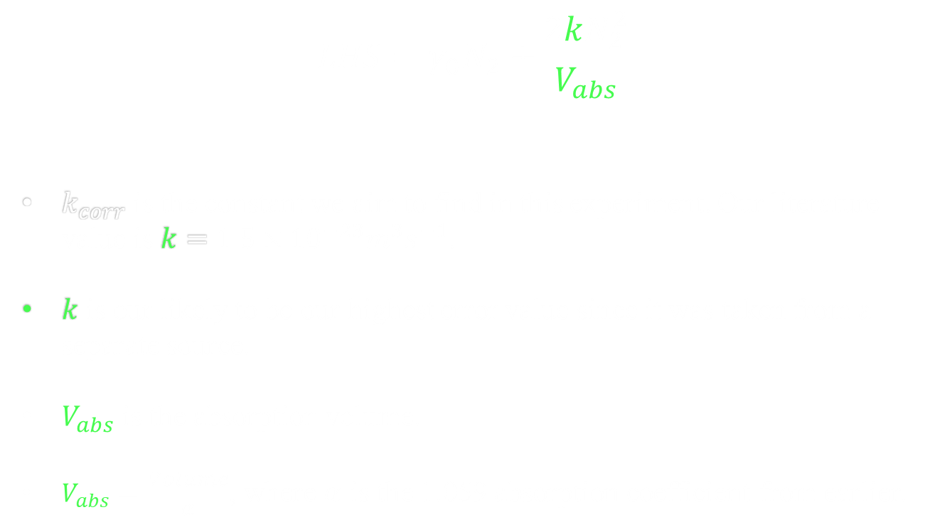
RHS of Equilibrium Population Equation: $k$ and $V_{abs}$
$$LHS=γ_{0}N_{2}+\frac{2kN_{2}^{2}}{V_{abs}}$$
$k_{corr}$ is the constant we aim to find in this experiment. Our literature value is $k=1.5×{10}^{−23}m^{3}s^{−1}$.
$k$ is our likely to be our highest error value since it was taken from a separate source.
$V_{abs}$ is the absorption volume.
$V_{abs}=\frac{Volume}{α}$, where $α$ is the 1.059 absorption coefficient from earlier.
Notes:
Pictured to the right are 2 fiber cables with a guard surrounding the actual fibers on the end. You can assess from the photo that any volume of actual fiber will be very small in the range of 𝜇𝑚.
Include that kcorrected was done, and current literature k didn’t make equilibrium eqn match.

Slide 13
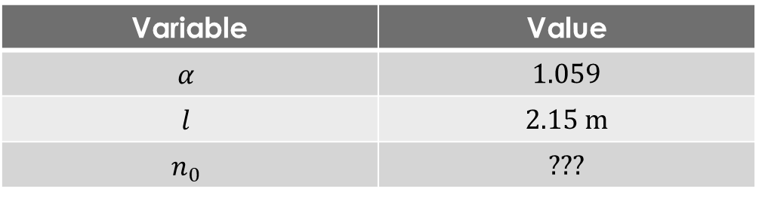
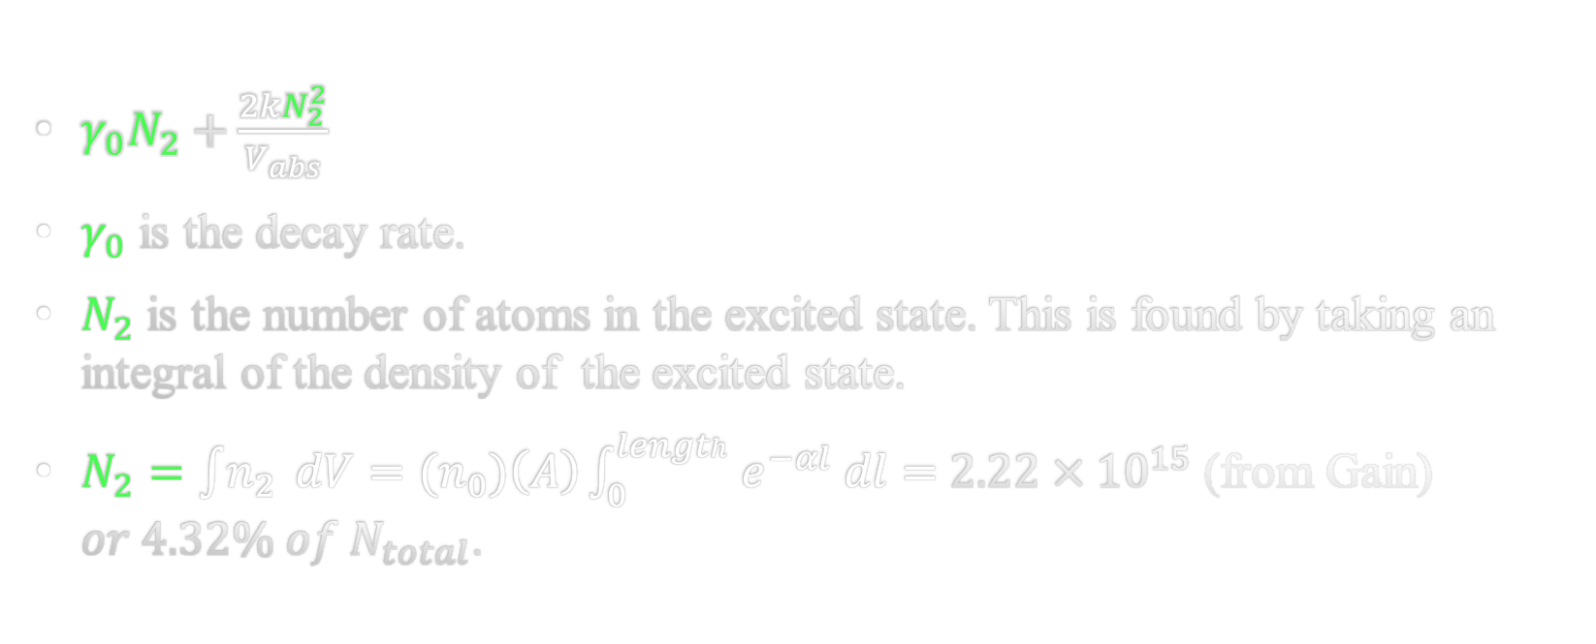
RHS of Equilibrium Population Equation: $γ_{0} and N_{2}$
Standard
Density Dependent
$γ_{0}N_{2}+\frac{2kN_{2}^{2}}{V_{abs}}$
$γ_{0}$ is the decay rate.
$N_{2}$ is the number of atoms in the excited state. This is found by taking an integral of the density of the excited state.
$N_{2}=\int{n_{2}} dV={(n}_{0})\left(A\right)\int_{0}^{length}{e^{−αl} dl}=$ $2.22×{10}^{15}$ (from Gain) $or 4.32\% of N_{total}$.
Variable | Value
$$α$$ | 1.059
$$l$$ | 2.15 m
$$n_{0}$$ | ???
Notes:
Emphasize standard decay rate and density dependent decay rate.

Slide 14
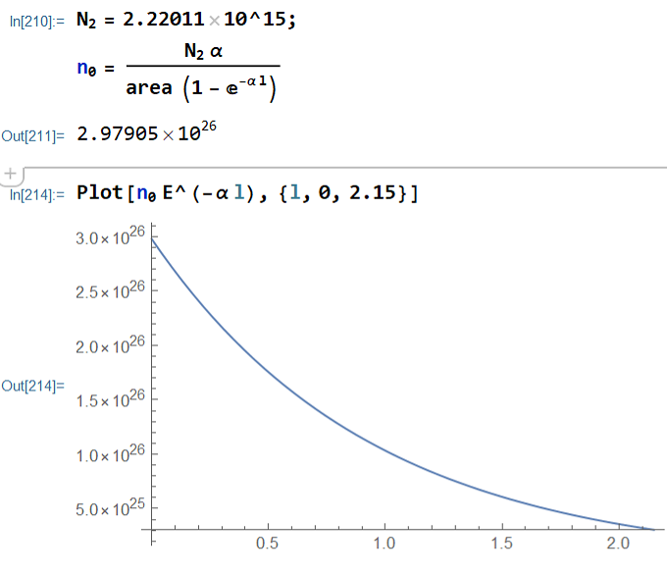
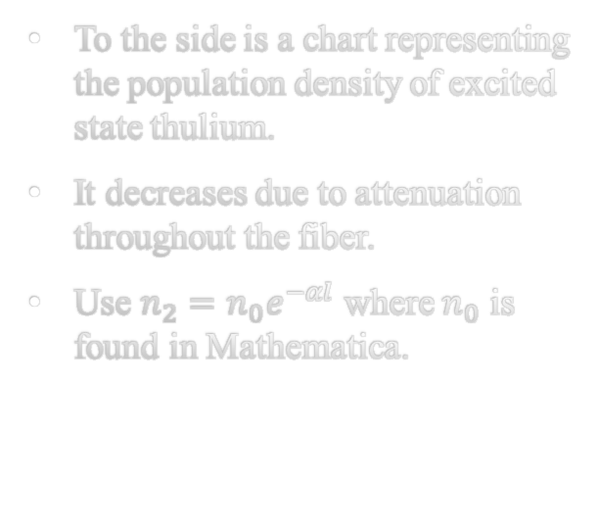
Excited State Population Density
To the side is a chart representing the population density of excited state thulium.
It decreases due to attenuation throughout the fiber.
Use $n_{2}=n_{0}e^{−αl}$ where $n_{0}$ is found in Mathematica.

Slide 15
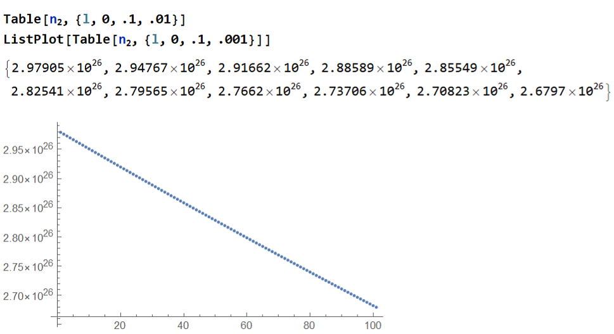
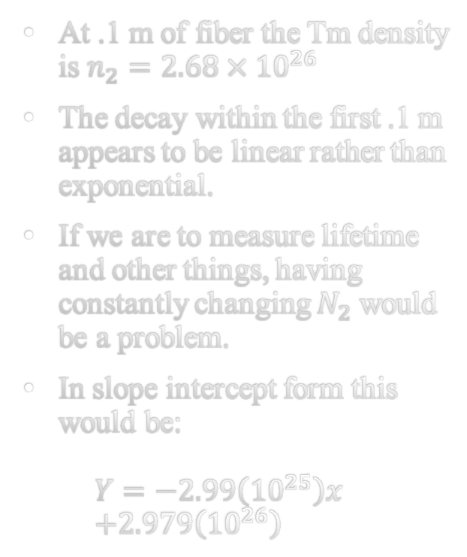
Excited State Population Density in The First 10 cm of Fiber
At .1 m of fiber the Tm density is $n_{2}=2.68×{10}^{26}$
The decay within the first .1 m appears to be linear rather than exponential.
If we are to measure lifetime and other things, having constantly changing $N_{2}$ would be a problem.
In slope intercept form this would be: $Y=−2.99\left({10}^{25}\right)x$ $+2.979\left({10}^{26}\right)$
Notes:
The slope intercept form is shown on the next slide.
Explain Mathematica notation. Mention at this point how the literature value of k isn’t very reliable since the theorists from other papers didn’t really provide a compelling argument for the value of k. Using this short length of fiber makes our excited state fairly uniform. This eliminates systematic errors like stimulated emission.

Slide 16
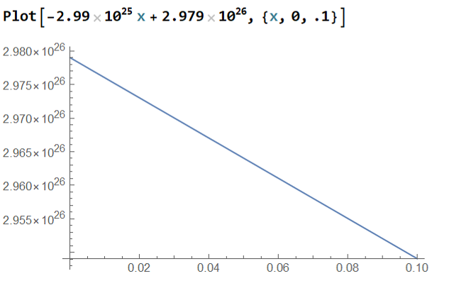
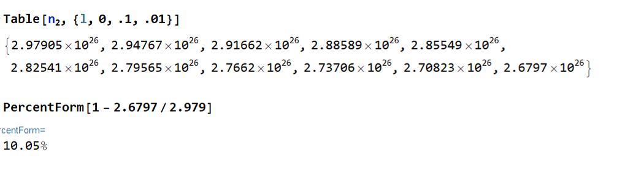


$$∆ in Population Density \\ Along Length\left(l\right)$$
We find our difference in $n_{2}$ population to be 10.05 % by using Mathematica.
We also see that our slope here looks identical to the one from last slide.

Slide 17
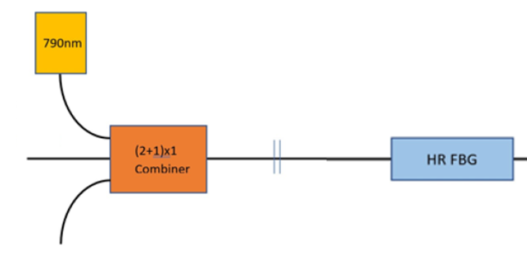
10 cm
We could add another laser into the combiner to increase the power input.

Slide 18
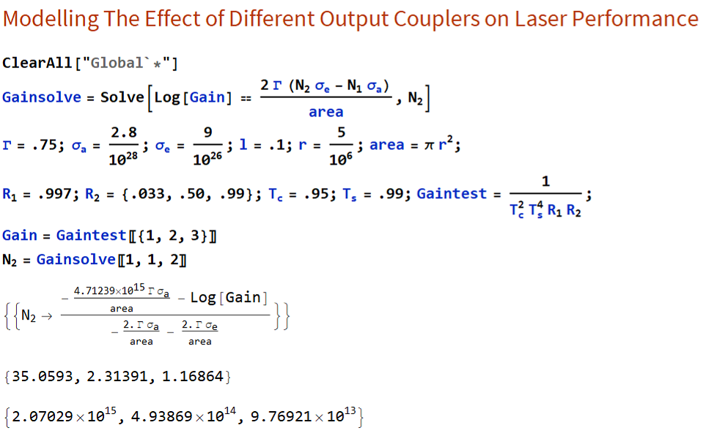
Notes:
Do they want to see some of the actual optical mirrors and pieces that we purchased before next slide.

Slide 19
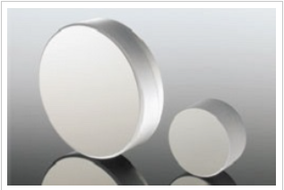
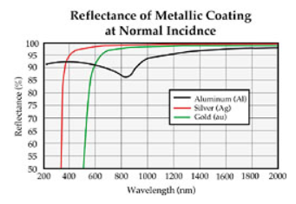
Experimental Differences Due to Change in Reflectivity
ITF Technologies
Partially Silvered Mirror
Ravg > 97% for protected silver
Notes:
We got some equipment to enable accurate testing of our proposed experiments.

Slide 20
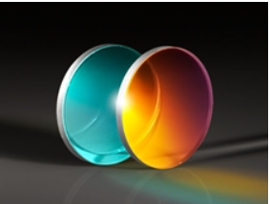
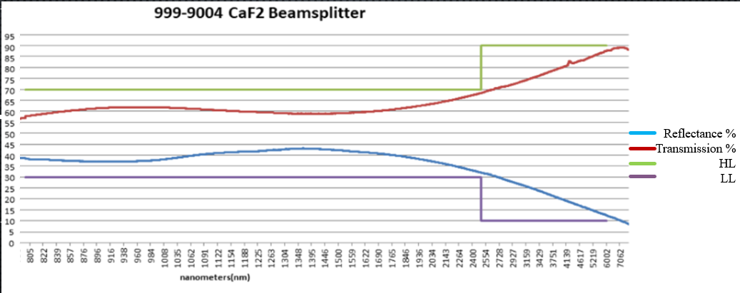
Edmund Optics Beam Splitter Specs
𝜆=2058 nm

Slide 21
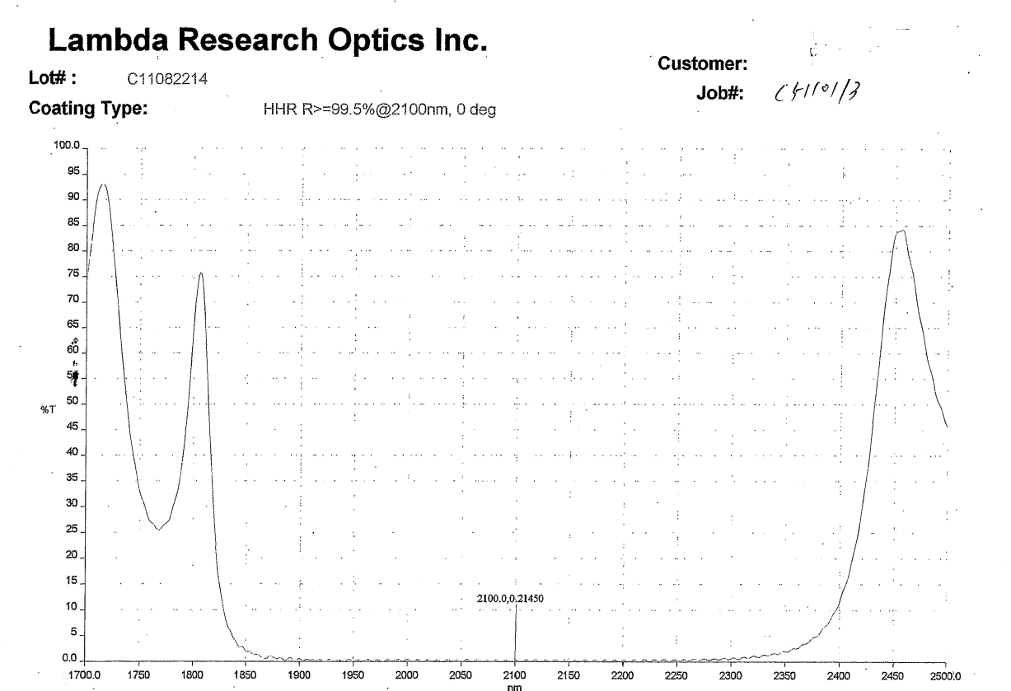
CaF2
HR
%T
𝜆

Slide 22

Sticking to The Equilibrium Equation
We acquire a steady state population while lasing.
What happens once we turn the laser off?
We use –
$$γ_{eff}=γ_{0}+\frac{2kN_{2}}{V}$$
Notes:
Derive Where that form came from.
Right after this slide we want to show a shortened length and photodetector, but cut off the high reflector and not that it’s a 10 cm length and put a photodetector on the output. Just the image pretty much.

Slide 23
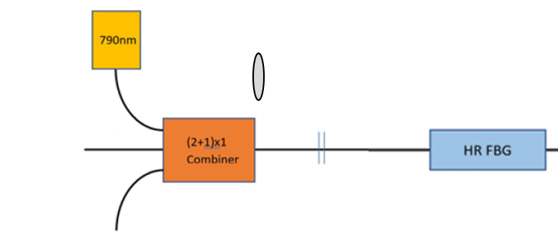
High-Reflecting
Mirror
Notes:
Say we’ll pump the tm fiber and then turn it off to see how the fluorescence decays. There are two separate decay rates, the fluorescence decay and the excited state population decay.
Dn/dt = (gamma + kvN) N, factor out the N to get the gamaeffective. Power of fourlece is equal to k* dn/dt. And dp/dt/p would serve as a double derirvatie, making a separate decay rate from the dn/dt result.

Slide 24
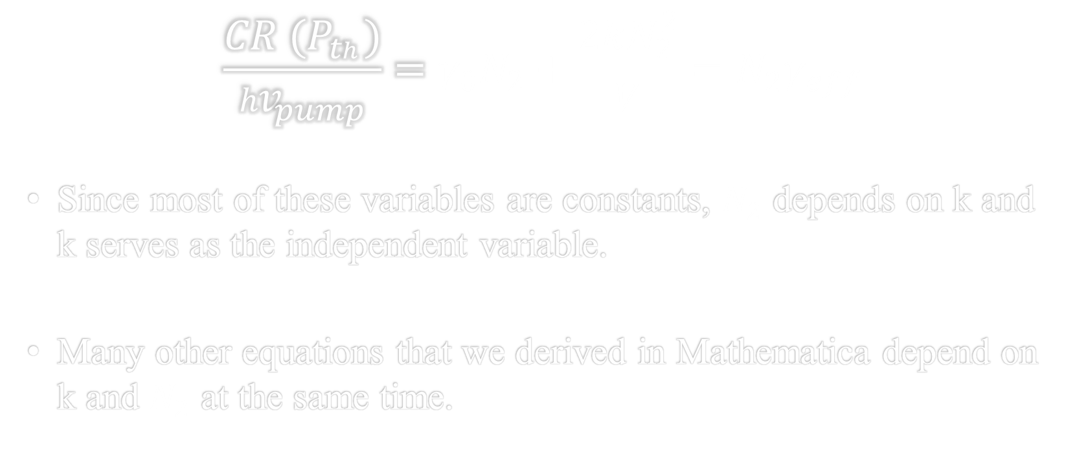
K’s Effect on Everything
$$\frac{{CR (P}_{th})}{{hv}_{pump}}=γ_{0}N_{2}+\frac{2kN_{2}^{2}}{V}=N_{2}γ_{eff}$$
Since most of these variables are constants, $N_{2}$ depends on k and k serves as the independent variable.
Many other equations that we derived in Mathematica depend on k and $N_{2}$ at the same time.

Slide 25
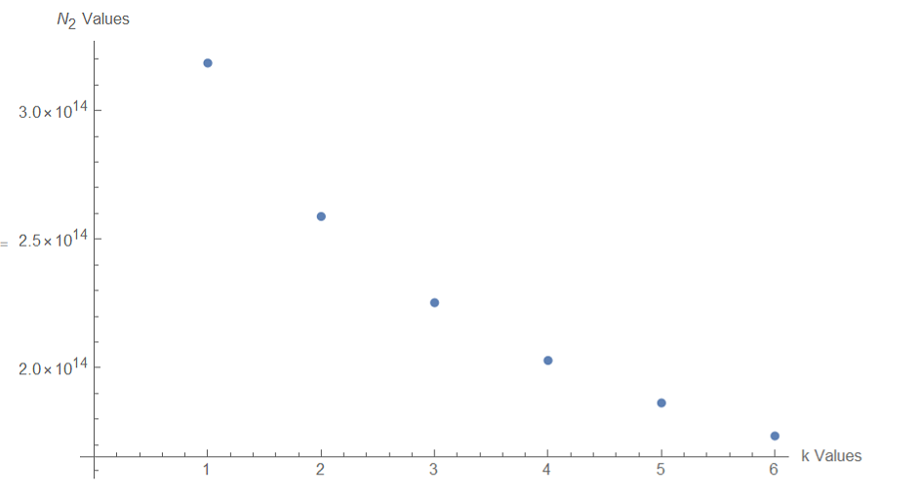

$N_{2}$’s Dependence on k

Slide 26
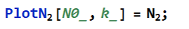
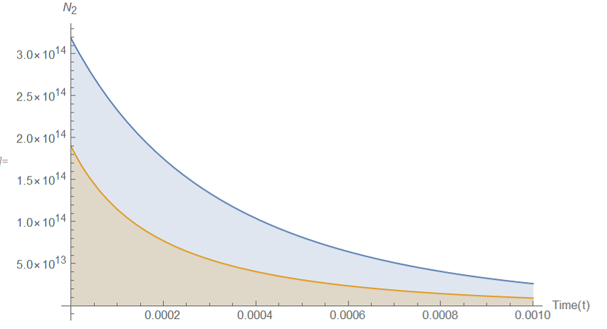
Predictions of Decay After Turning Off The Pump Source
Notes:
After the laser is turned off, we use 2 most likely values of k to determine other variables.
N0 in the code here does represent N2, just at time 0. It’s confusing at the moment but for coding purposes it was best to denote it as N0 since it is at time = 0.

Slide 27
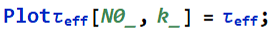
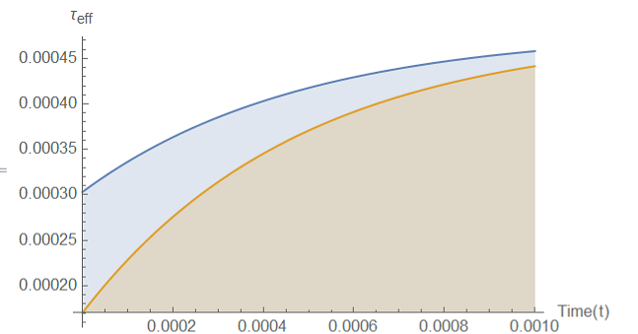
Lifetime Change of The $N_{2}$ State Over Time
Notes:
We can’t measure this unfortunately since it happens inside the laser, and we don’t have monitoring technology.

Slide 28
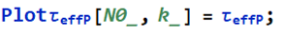
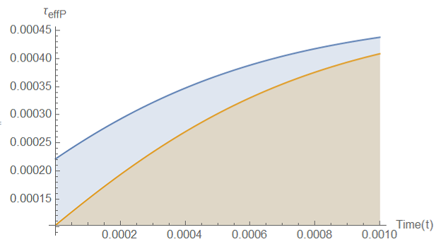
Fluorescence Output Effective Lifetime
Notes:
Explain what Tau effective P actually means.
Talk about how this is what we will measure with a photodetector and then ease into the next slide. This will mention how the two curves are relatively similar.

Slide 29
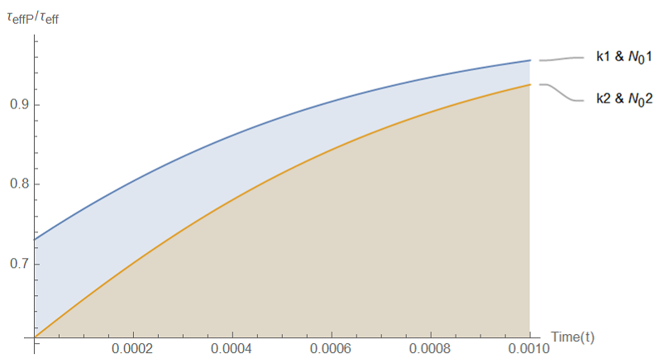

Lifetime Comparison of Power Lifetime / $N_{2}$ State Lifetime With Two k Values
Notes:
The power lifetime slope appears to be less steep than the excited state population slope given that it’s rising from around .75 to 1. The use of our larger k2 value indicates that a larger k2 results in a smaller N2 state. But could there be more accurate k values? Next slide

Slide 30
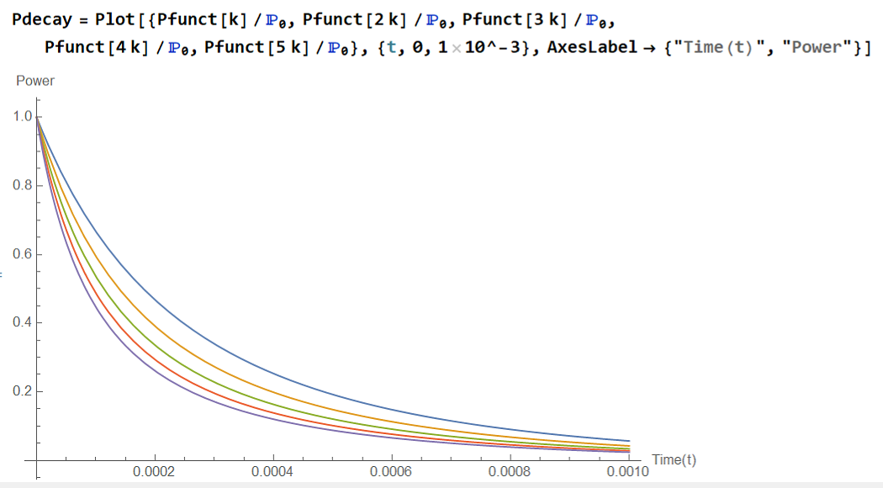
Power Decay Over Initial Power – The Solution
Notes:
Explain how we will make more simulated decays for varying k values and then compare all our hypothetical k values to what the signal shows us when we actually run the experiment.
Again, we couldn’t really do this until recently because of the virus and our part for the system got stuck in customs for a couple months and was reshipped. This serves as the most direct way to compare our theory to actual experimentation. We hope this will help us reveal a true value of k. Emphasize more that there is a mystery to solve. Why is our model not predicting the correct threshold? Observing threshold is simple, so it’s likely that there was an error somewhere in our theoretical model.

